Slide 1


Abstra
Lazar Milicevic
Weekly support report
Support, Challenges, Sollutions
30.01.2025

Slide 2
Agenda
1. Zendesk ↔ AWS Integration Progress
3. Zendesk Ticket Management
5. Next Steps
2. NPS Tool Evaluation
4. Challenges & Solutions

Slide 3
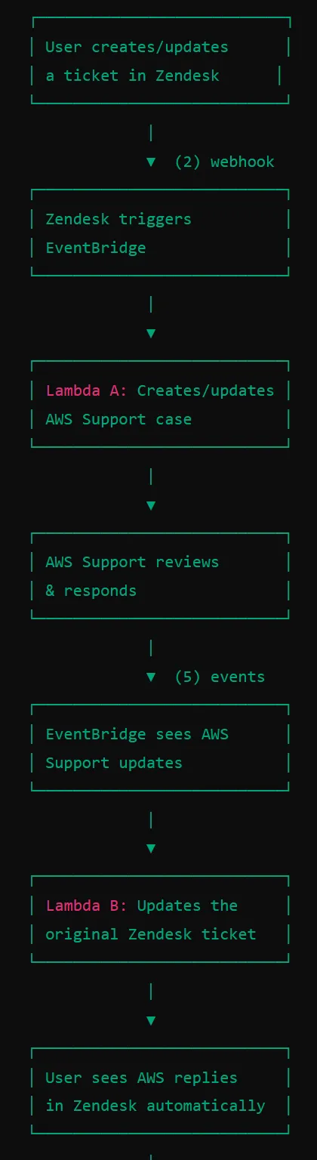
Zendesk ↔ AWS Integration Progress
Customer success: Weekly Support Report – 30.01.2025
What was done:
✅ Successfully completed the first phase of Zendesk ↔ AWS integration.
✅ Second phase successfully completed:
AWS Support status updates are now automatically reflected in corresponding Zendesk tickets.
Implemented AWS EventBridge to trigger updates in real time.
Enhanced data transfer to ensure ticket priority, comments, and attachments are synced seamlessly.
Adjusted API requests to align with AWS Support case parameters.
Tickets created via Zendesk form are now automatically forwarded to AWS Support.
AWS Support cases are updated in real-time.
Implemented bidirectional synchronization for full status tracking.
Rigorous testing conducted with real and test tickets.
Fully documented the integration process in Notion.
✅ Zendesk ↔ AWS Integration Progress (Testing & Finalization)
Extensive end-to-end testing conducted:
Simulated multiple real-case scenarios for Zendesk → AWS and AWS → Zendesk flows.
Tested comment synchronization to prevent duplicate messages.
Validated priority mapping to ensure correct severity levels in AWS cases.
Verified attachment handling for smooth file transfers.
Debugged and resolved any edge-case issues to ensure stability.
🚀 Integration is now fully operational and ready for production!

Slide 4
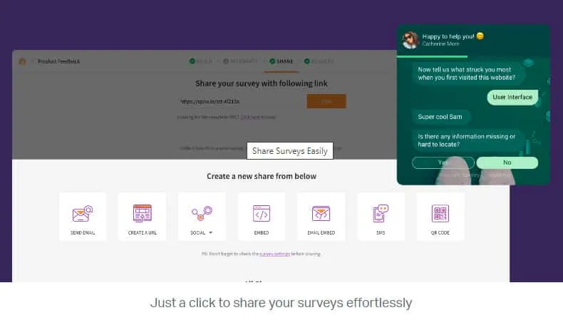
NPS Tool Evaluation
Customer success: Weekly Support Report – 30.01.2025
What was news:
✅ NPS Research done, Prepared notion document
FullStory and Canny do not support embedded survey widgets.
SurveySparrow selected as the best option due to pricing ($19/month), easy integration, and user-friendly interface.
Scheduled a meeting with SurveySparrow representatives to discuss implementation.
Canny remains an option for collecting feedback, but lacks survey capabilities.

Slide 5
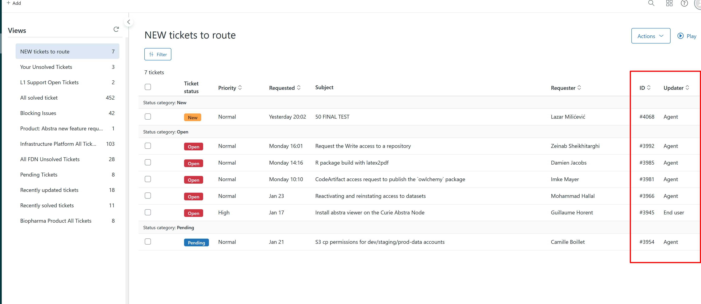
Zendesk Ticket Management
Customer success: Weekly Support Report – 30.01.2025
What was done:
✅ Regular daily activities, providing support via Zendesk and Slack dedicated channels
Routed tickets to the appropriate teams.
Investigated and resolved various issues reported by end users.
Communicated directly with users to clarify and resolve their problems.
Updated the 'New tickets to route' view by adding ID and Updater fields for better readability.
Verified and corrected field IDs for dataset-related fields.

Slide 6
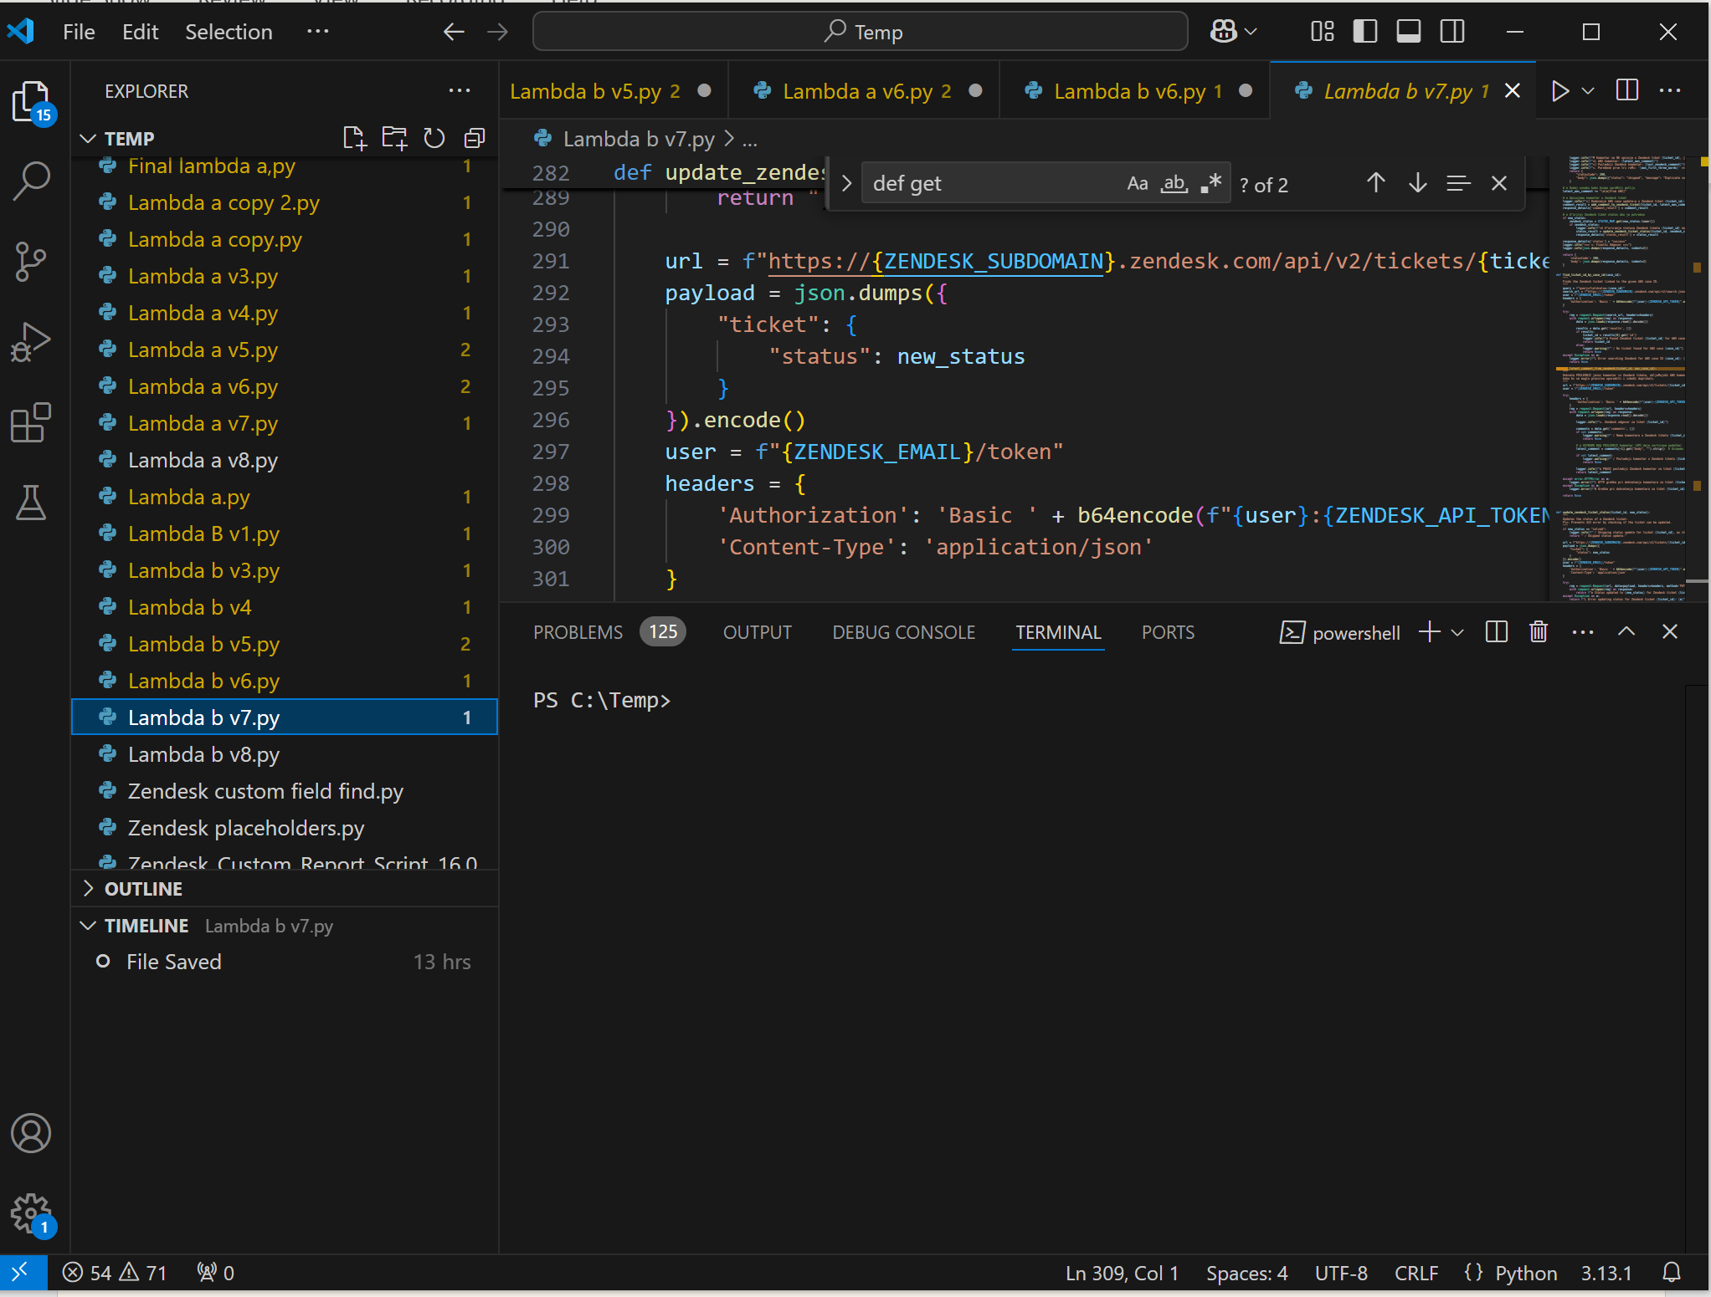
Challenges & Solutions
Customer success: Weekly Support Report – 30.01.2025
What was done:
✅ Successfully done!
Bunch of coding, creativity, trying, testing and fun!
Endless comment loop (AWS ↔ Zendesk): Implemented “[From AWS]” and “[From Zendesk]” tags to prevent duplicates.
Incorrect AWS API parameters: Adjusted API calls to comply with AWS Support API constraints.
Permission issues with Lambda execution: Updated IAM policies to ensure Lambda could read/write to AWS Support and Zendesk.
Ticket routing challenges: Enhanced query logic for retrieving AWS Case IDs from Zendesk tickets.
Hyperlink field in Zendesk: Identified and corrected the field issue for dataset ID and hyperlink display.

Slide 7
Next Steps
Customer success: Weekly Support Report – 30.01.2025
What will be done:
Continue optimizing the Zendesk ↔ AWS integration.
Se what next based on feedback from the SurveySparrow meeting.
Further automate ticket routing and prioritization.
Enhance documentation and ensure knowledge transfer within the team.
Conduct a final round of testing before fully launching the integration.

Slide 8
Thank you!

